Slide 1



Slide 2


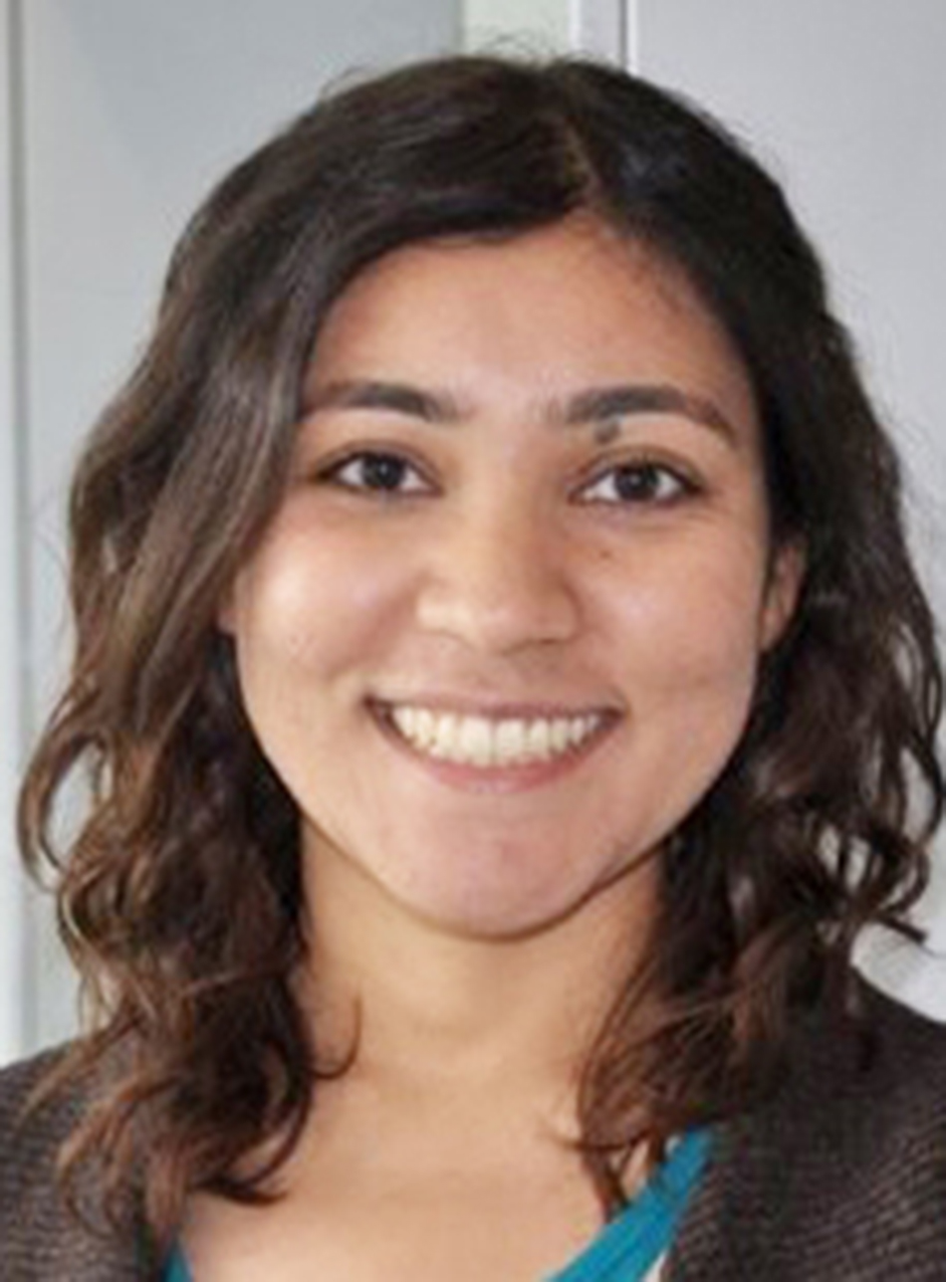
Zahra switched her major to physics to seek a deeper understanding of materials science. As she worked at NIST to get a taste of research, she instead discovered her passion for computer science.
Currently, Zahra works on Google Search, debugging and fixing issues before they become visible to users.
Learn more: go.aps.org/deeperInSight

Slide 3


Writing and debugging code
Collecting and analyzing data
Modeling, simulating, and prototyping systems
Maintaining, troubleshooting, and repairing equipment
Rendering designs in formats such as CAD and LabView
Learn more: go.aps.org/deeperInSight

Slide 4


Job Satisfaction of
Physics Bachelors
In Private Sector
STEM Positions
(2013 & 2014)
aip.org/statistics
Learn more: go.aps.org/deeperInSight

Slide 5
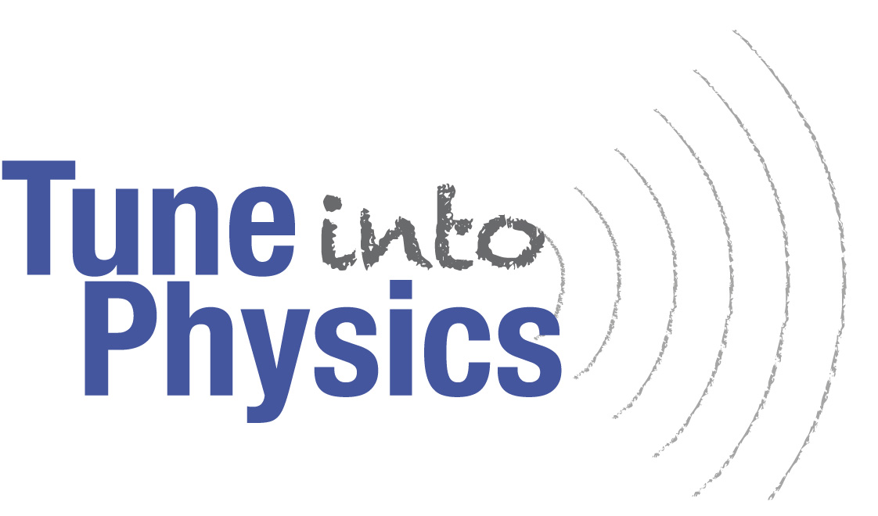

This physics career guide includes profiles of physicists, professional advice, articles on career programs, and a directory of employers.
Free digital copies are available to all APS members.
go.aps.org/careers2020
Learn more: go.aps.org/deeperInSight

Slide 6
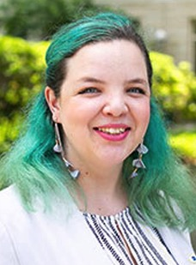
Due to her passion for combining disciplines in creative ways, Isabel pursued degrees in physics and fine arts. This summer, Isabel worked as the APS/SPS Public Engagement intern. She published a virtual gallery exhibition featuring her senior thesis exhibition, “It’s Not That Scary,” as well as the work of several other artists.
Learn more: go.aps.org/deeperInSight

Slide 7



Many noise-canceling headsets create an anti-wave to counter external noise. An incoming soundwave detected at the entrance is converted into an electronic voltage, which is then used to create the anti-wave. Since electronic signals travel a lot faster than soundwaves, the anti-wave is created quickly enough to cancel out incoming sounds!
Learn more: go.aps.org/deeperInSight

Slide 8
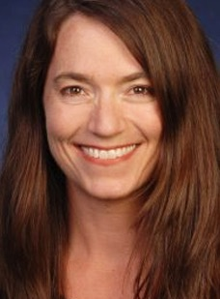
Julia found a job at the National Institute of Standards and Technology (NIST) through
her network. After working in different areas
at NIST, she now leads a group responsible
for the fundamental measurements of temperature and pressure.
“Talk to the grad students before applying to a school and take skills-based classes.”
Learn more: go.aps.org/deeperInSight

Slide 9

Collaboration and communication with scientists and engineers
Troubleshooting and maintaining equipment and scientific facilities
Evaluating engineering designs and parts
Building and enhancing equipment for use in field work
Performing computer simulations
Learn more: go.aps.org/deeperInSight

Slide 10
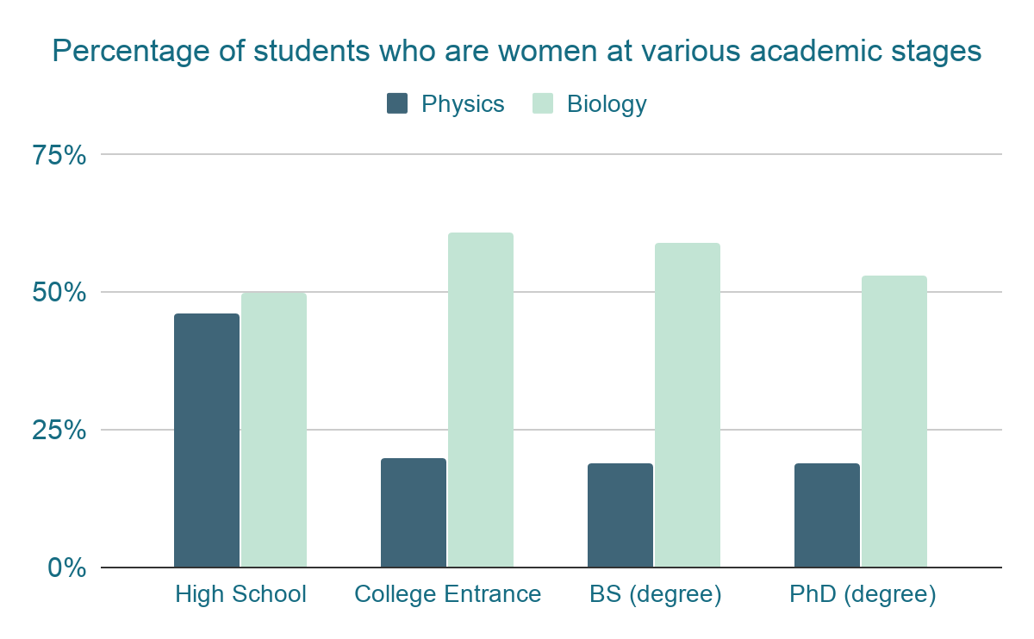

Visit STEPUPphysics.org to help empower young women to pursue physics degrees.
Learn more: go.aps.org/deeperInSight

Slide 11
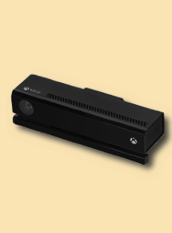
The Kinect contains two motion detectors: a video camera to recognize physical features and a depth sensor, which transmits near-infrared laser light that gets reflected off of various parts of the room and is detected by the sensor.
The time-of-flight between transmission and detection allows the detector to build a 3D image!
Learn more: go.aps.org/deeperInSight

Slide 12

During his PhD, Ramón became interested in issues contributing to the lack of diversity in physics. He completed a AAAS Fellowship in the Department of Education and then spent a few years consulting with academic institutions.
Currently he is an assistant professor specializing in physics education research with a focus on equity and inclusion.
Learn more: go.aps.org/deeperInSight

Slide 13

A physics degree can qualify you for an astounding variety of careers, including education, government labs, medical and tech facilities, even Wall Street!
Each Across the Spectrum playing card deck includes profiles of women and gender minorities and their various professions, showing how diverse backgrounds and experiences contribute to a stronger scientific community.
Learn more: go.aps.org/deeperInSight

Slide 14
No. of Tenured /Tenure-Track Faculty Hired by Physics Departments
aip.org/statistics
Learn more: go.aps.org/deeperInSight

