Slide 1
Radio Astronomy
Prepared for the MASPG Meeting
February 2023
Richard Colarco
Using Material From Sky & Telescope Magazine, Wikipedia, National Radio Astronomical Observatory

Slide 2
Some Perspective
All astronomy makes use of the universe’s two macro forces
Electromagnetic force
Gravitational force
In 1920 “astronomy” meant “visible light astronomy”
Our eyes were essentially the only detectors we had
When we talk about “radio astronomy,” we mean electromagnetic wavelengths longer than far infrared
Boundary between radio and far IR is approximately 100 GHz
Wavelength of 3 mm
Radio telescopes usually look like antennas
Telescopes for shorter wavelengths usually look like lenses

Slide 3
Why Do Radio Astronomy?
Radio astronomy “illuminates” (pun intended) features of the universe not apparent from other forms of astronomy

Slide 4
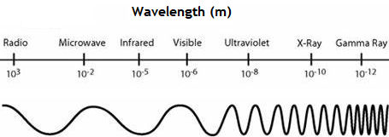
The Electromagnetic Spectrum
Type of Radiation | Frequency Range (Hz) | Wavelength Range
gamma-rays | 10²⁰ - 10²⁴ | < 10⁻¹² m
x-rays | 10¹⁷ - 10²⁰ | 1 nm - 1 pm
ultraviolet | 10¹⁵ - 10¹⁷ | 400 nm - 1 nm
visible | 4 - 7.5*10¹⁴ | 750 nm - 400 nm
near-infrared | 1*10¹⁴ - 4*10¹⁴ | 2.5 μm - 750 nm
infrared | 10¹³ - 10¹⁴ | 25 μm - 2.5 μm
microwaves | 3*10¹¹ - 10¹³ | 1 mm - 25 μm
radio waves | < 3*10¹¹ | > 1 mm
Astronomers explore the universe in all these regimes

Slide 5
Very Short Physics Lesson
Quantum mechanics tells us that electromagnetic radiation exhibits properties of both waves and particles
At the radio end of the spectrum, wave properties dominate
We seldom talk about “radio photons,” although they exist
At the gamma ray end, particle properties dominate
We seldom talk about the frequency of a gamma ray
The universe responds to EM radiation of different wavelengths in different ways

Slide 6
Pre WWII History
In the 1920s and 1930s, Bell Telephone Laboratories was searching for the origin of static that affected radio communications
Bell engineer Karl Jansky built a 100-foot by 20-foot antenna, and pointed it at the sky
Jansky found static from thunderstorms (no surprise), but also found a steady hiss that reached maximum intensity every 23 hours and 56 minutes
The precise period of Earth’s rotation
Radio astronomy was born!

Slide 7
Jansky’s Antenna

Slide 8
The Jansky Hiss
First guess – radio noise from the sun
Proved wrong
Signal was strongest in direction of the galactic plane (center of the Milky Way)
We now know the noise comes from a 4-million-solar-mass black hole called Sagittarius A*
In the 1920s it was not commonly recognized that the Milky Way is our home galaxy, and black holes were completely unknown

Slide 9
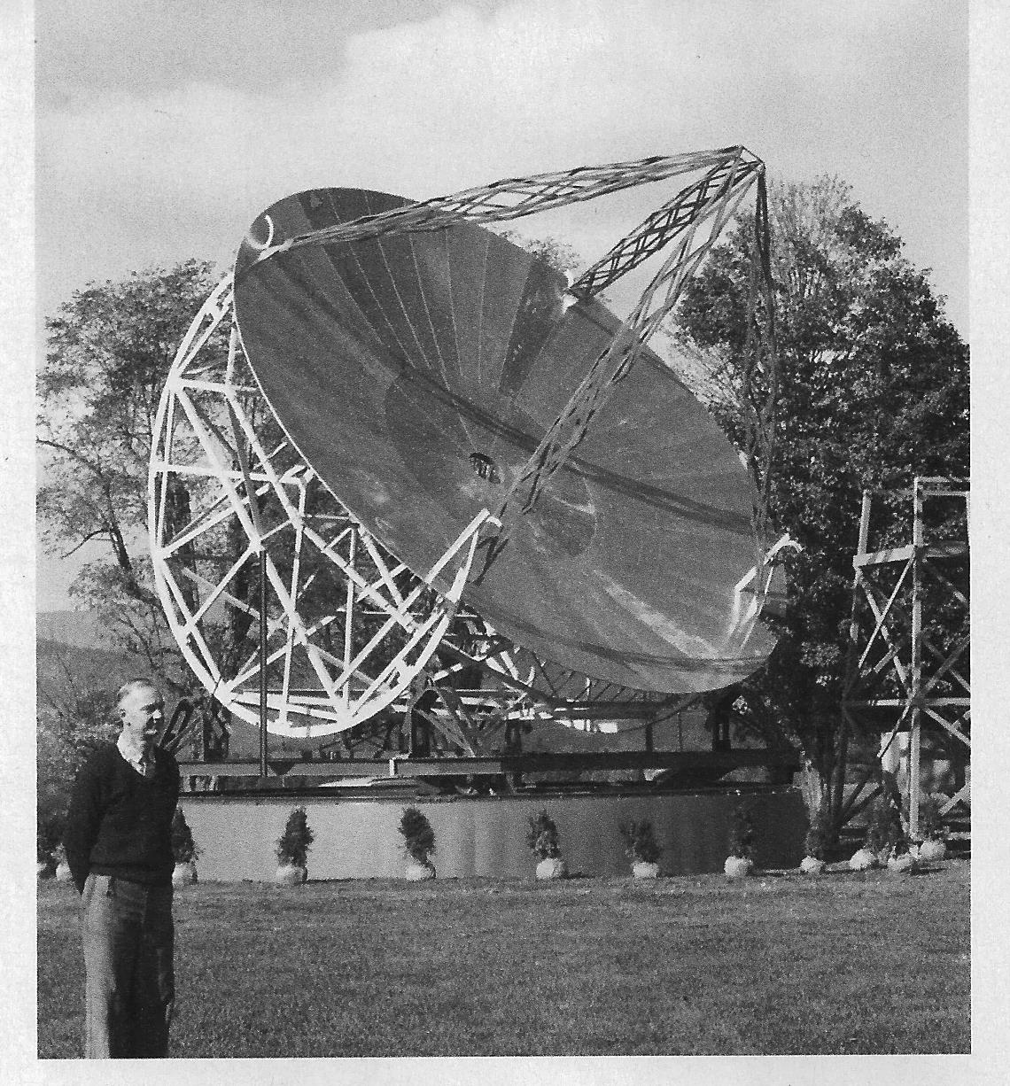
Grote Reber
In the 1930s, Grote Reber built a 30-foot parabolic dish antenna in his back yard. He later moved it to the National Radio Astronomical Observatory in Green Bank WV. (Notice the elegant landscaping.) Reber mapped radio emissions from a broad swath of the galaxy. Two of his original contour plots from 1943 are below. Photo courtesy NRAO. Contour plot, Sky & Telescope Magazine, 1949

Slide 10
Reber’s Discoverys
Cassiopeia A, a supernova remnant
Cygnus A, a radio galaxy
Puppis A, a supernova remnant
These sources are commonly used in calibrating radio telescopes and communications equipment, since their locations and strengths are known with great precision

Slide 11
James Hey
In 1942 physicist James Hey found radio signals originating from the Sun
Signals originated in electrons whirling around magnetic fields associated with sunspots
Solar flares are another source

Slide 12
WWII and Later
WWII spurred rapid development in microwave electronics and antennas for radar and communications
These developments were eagerly adopted by radio astronomers

Slide 13
Pulsars
In 1967, Cambridge University astronomer Jocelyn Bell discovered evenly-timed radio signals coming from deep space
Initial skepticism gave way to understanding that these signals came from a rapidly rotating and magnetized neutron star, later named a “pulsar”

Slide 14
Quasars
In 1953, Geoffrey Burbidge theorized that synchrotron radiation could come from charged particles rotating at relativistic speed along magnetic field lines
Confirmation came in 1963 when a team of scientists demonstrated that a star-like pinpoint of light, 3C 273, was actually more than a billion light years away and was producing synchrotron radiation
Many other sources were discovered, and were named quasi-stellar radio sources, or “quasars”

Slide 15
Quasars
We now know quasars are supermassive black holes that emit streams of matter at relativistic speeds from their poles
Although synchrotron radiation was predicted, no theory predicted the existence of quasars
Quasars are among the oldest objects observed in our universe, and help establish the “size” of the universe

Slide 16
Gravitational Waves
Gravitational waves grabbed the headlines in recent years when they were first detected.
But what causes them?
The Karl G. Jansky Very Large Array played a role in studying the physics of these cosmic catastrophes.
Three months of observations from several observatories led researchers to a titanic collision of neutron stars in a galaxy 130 million light-years from Earth.
Neutron stars are super-dense objects left over from the deaths of massive stars.

Slide 17
Neutron Stars
Neutron stars are magnetically active and have very strong gravitational fields.
When these stars collide, they not only send gravitational waves out through space, but they also give off strong radio emissions.
That’s what the VLA, plus the Australia Telescope Compact Array and the Giant Metrewave Radio Telescope in India combined to study.
The merger of neutron stars sets off a huge outburst of energy and material and gives scientists new insight into the phenomenon behind the creation of gravitational waves.

Slide 18
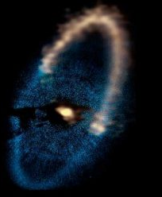
Exoplanets
Millimeter/submillimeter-wave telescope arrays such as ALMA can see more detail than current optical or infrared telescopes. The longer waves it detects are not scattered or reflected by interplanetary dust, either in the extrasolar system or our own Solar System.
Another important advantage is that, at millimeter and submillimeter wavelengths, the star is not glaring and overwhelming our view of its potential planets as it does in shorter wavelengths. While the star is still brighter than its planet, the difference in brightness between the two is far less in millimeter radiation.
ALMA sees planetary systems in the earliest stages of their formation.

Slide 19
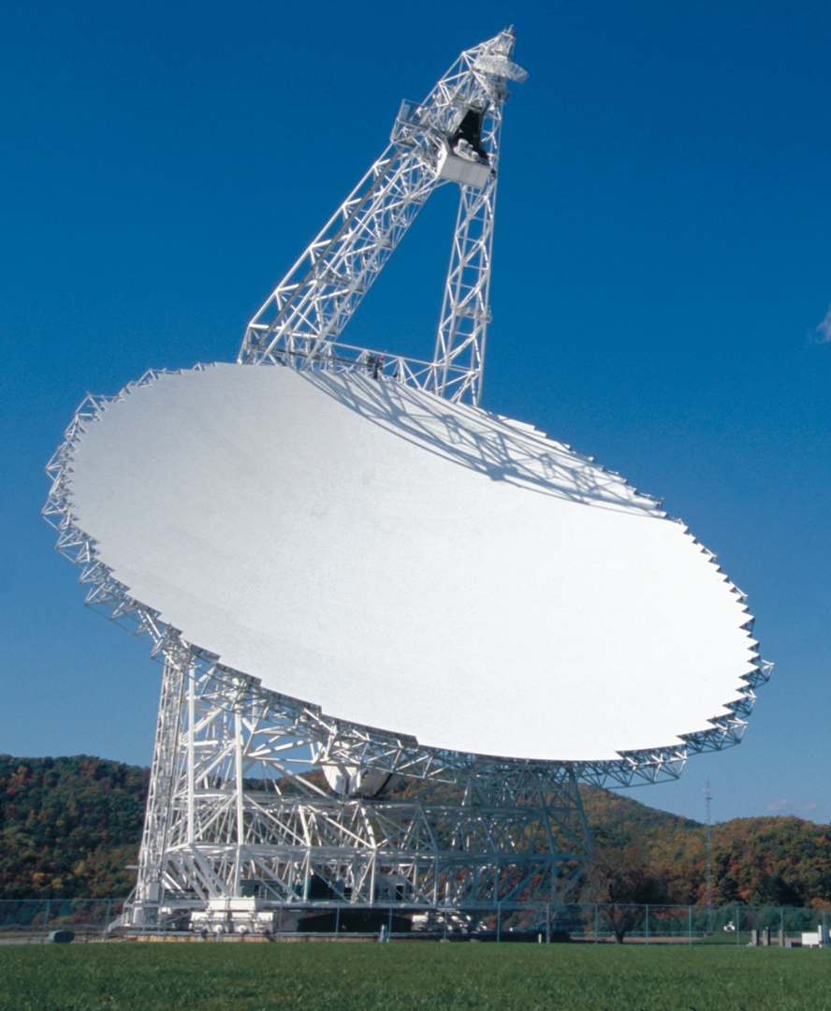
Radio Astronomy Hardware
Weak signals require large antennas
The Green Bank WV antenna is 360 feet in diameter, the largest fully steerable antenna on Earth
59 dBi of gain at 1 GHz

Slide 20
Arecibo Dish
Located in Puerto Rico
Not movable
1007 feet in diameter
68 dBi of gain at 1 GHz
Has been used for SETI, RX and TX
Now, sadly, defunct

Slide 21
Five-Hundred-Meter Aperture Spherical Telescope
FAST
Located in SW China
Not movable
1640 feet in diameter
72 dBi of gain at 1 GHz
Has SETI as one of its science goals

Slide 22
Pointing Limitations
Arecibo and FAST (and other very large dishes) are not independently movable
Slight pointing versatility can be achieved by moving the receiver array (suspended at the antenna focus)
Essentially, you must wait until the motion of the Earth points the dish to the desired location

Slide 23
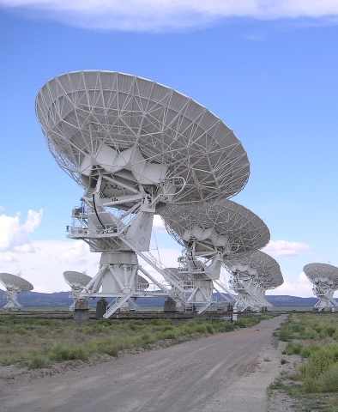
VLA
An array of smaller, movable antennas can produce much of the performance of a single, very large, immovable antenna, but can be pointed anywhere in the sky
The Very Large Array, near Socorro NM, is a good example
27 movable and steerable 82-foot antennas that can be tightly clustered, or separated by up to 26 miles
Featured in the movie Contact

Slide 24
ALMA
The Atacama Large Millimeter/submillimeter Array is the most complex astronomical observatory ever built on Earth. Teams from North America, East Asia, and Europe merged projects to develop this breakthrough scientific instrument in northern Chile.
ALMA is a premier telescope for studying the first stars and galaxies that emerged from the cosmic “dark ages” billions of years ago. We find them at great cosmic distances, with most of their light stretched out to millimeter and submillimeter wavelengths by the expansion of the Universe.
In the more nearby Universe, ALMA provides an unprecedented ability to study the processes of star and planet formation. Unimpeded by the dust that obscures visible-light observations, ALMA reveals the details of young, still-forming stars, and shows young planets still in the process of developing.

Slide 25
VLBA
The Very Long Baseline Array is a network of ten observing stations located across the United States. Each station consists of a 25-meter radio antenna dish and a control building. Radio signals captured by each antenna are amplified, digitized and recorded. The recorded data are then sent to Socorro, NM to be processed by a powerful computer known as a correlator. By combining their data, the stations form one of the world’s most powerful radio cameras.
The VLBA stations are located in areas with limited radio interference, and widely spread across the country. The distance between any two stations is known as their baseline
. The longer the baseline, the better the angular resolution
. The most widely separated antennas are at Mauna Kea in Hawaii and St. Croix in the U.S. Virgin Islands, which are 8,611 km apart. While each VLBA antenna is identical, each location is unique. Each station also has a webcam, so you can view them in real time.

Slide 26
Puzzles Remaining for Astronomers to Solve
In the 1990s, Big Bang mathematics called for the Universe to expand until its mass overcame its energy, and it then should slow down. So, astronomers tried to look back far enough in time (by looking deeper into the Universe where light from the past was still trying to reach us) to clock the expansion history, to see if they could measure the Universe’s deceleration.
They used what we call a “standard candle,” a bright event that unfolds exactly the same way every time. It is called a Type Ia supernova, and it’s the explosion of material off a violent implosion of a star.

Slide 27
Dark Energy
Two teams of astronomers, led by Saul Perlmutter in California and Brian Schmidt in Australia, found the same result: the supernovae were too dim at the distances they were supposed to be.
The Universe was in a neutral state at 400 thousand years after the Big Bang and remained that way until light from the first generation of stars started to ionize the hydrogen. After several hundred million years, the gas in the Universe was completely ionized.
Too dim for a standard candle means the distance is wrong, and the candle is actually farther away than thought. But to be farther away, then the Universe was not expanding the way the Big Bang mathematics said it should be. Instead, the Universe expanded slowly in its early years, but that expansion has increased over time. A kind of unseen, repulsive energy is pushing apart the structures of the Universe. It was called “Dark Energy,” and its proposal was highly controversial.

Slide 28
Dark Matter
In the 1930s, a Swiss astronomer named Fritz Zwicky came to a startling conclusion: the galaxies zooming around each other in clusters should not hold together at those incredible speeds. Simply put, their swarming speed should be tearing galaxies apart, but it isn’t. He suggested that galaxies must be beefier than we can detect, and he dubbed the invisible heavy glue “dark matter.”
Using the 300-foot radio telescope in Green Bank, Mort Roberts found huge halos of invisible hydrogen gas extending well beyond the visible disks of these galaxies. By clocking that gas, he and others extended the flat rotation curve several times the diameter of the visible galaxy. Clearly, he proved, galaxies are made of much more matter than can be detected by even the largest radio telescopes.

Slide 29
Summary
Radio astronomy gives us a way of looking at the universe that is different from what we can see with our eyes, and can teach us things about the universe that our eyes cannot

Slide 30
Questions?

